Slide 1
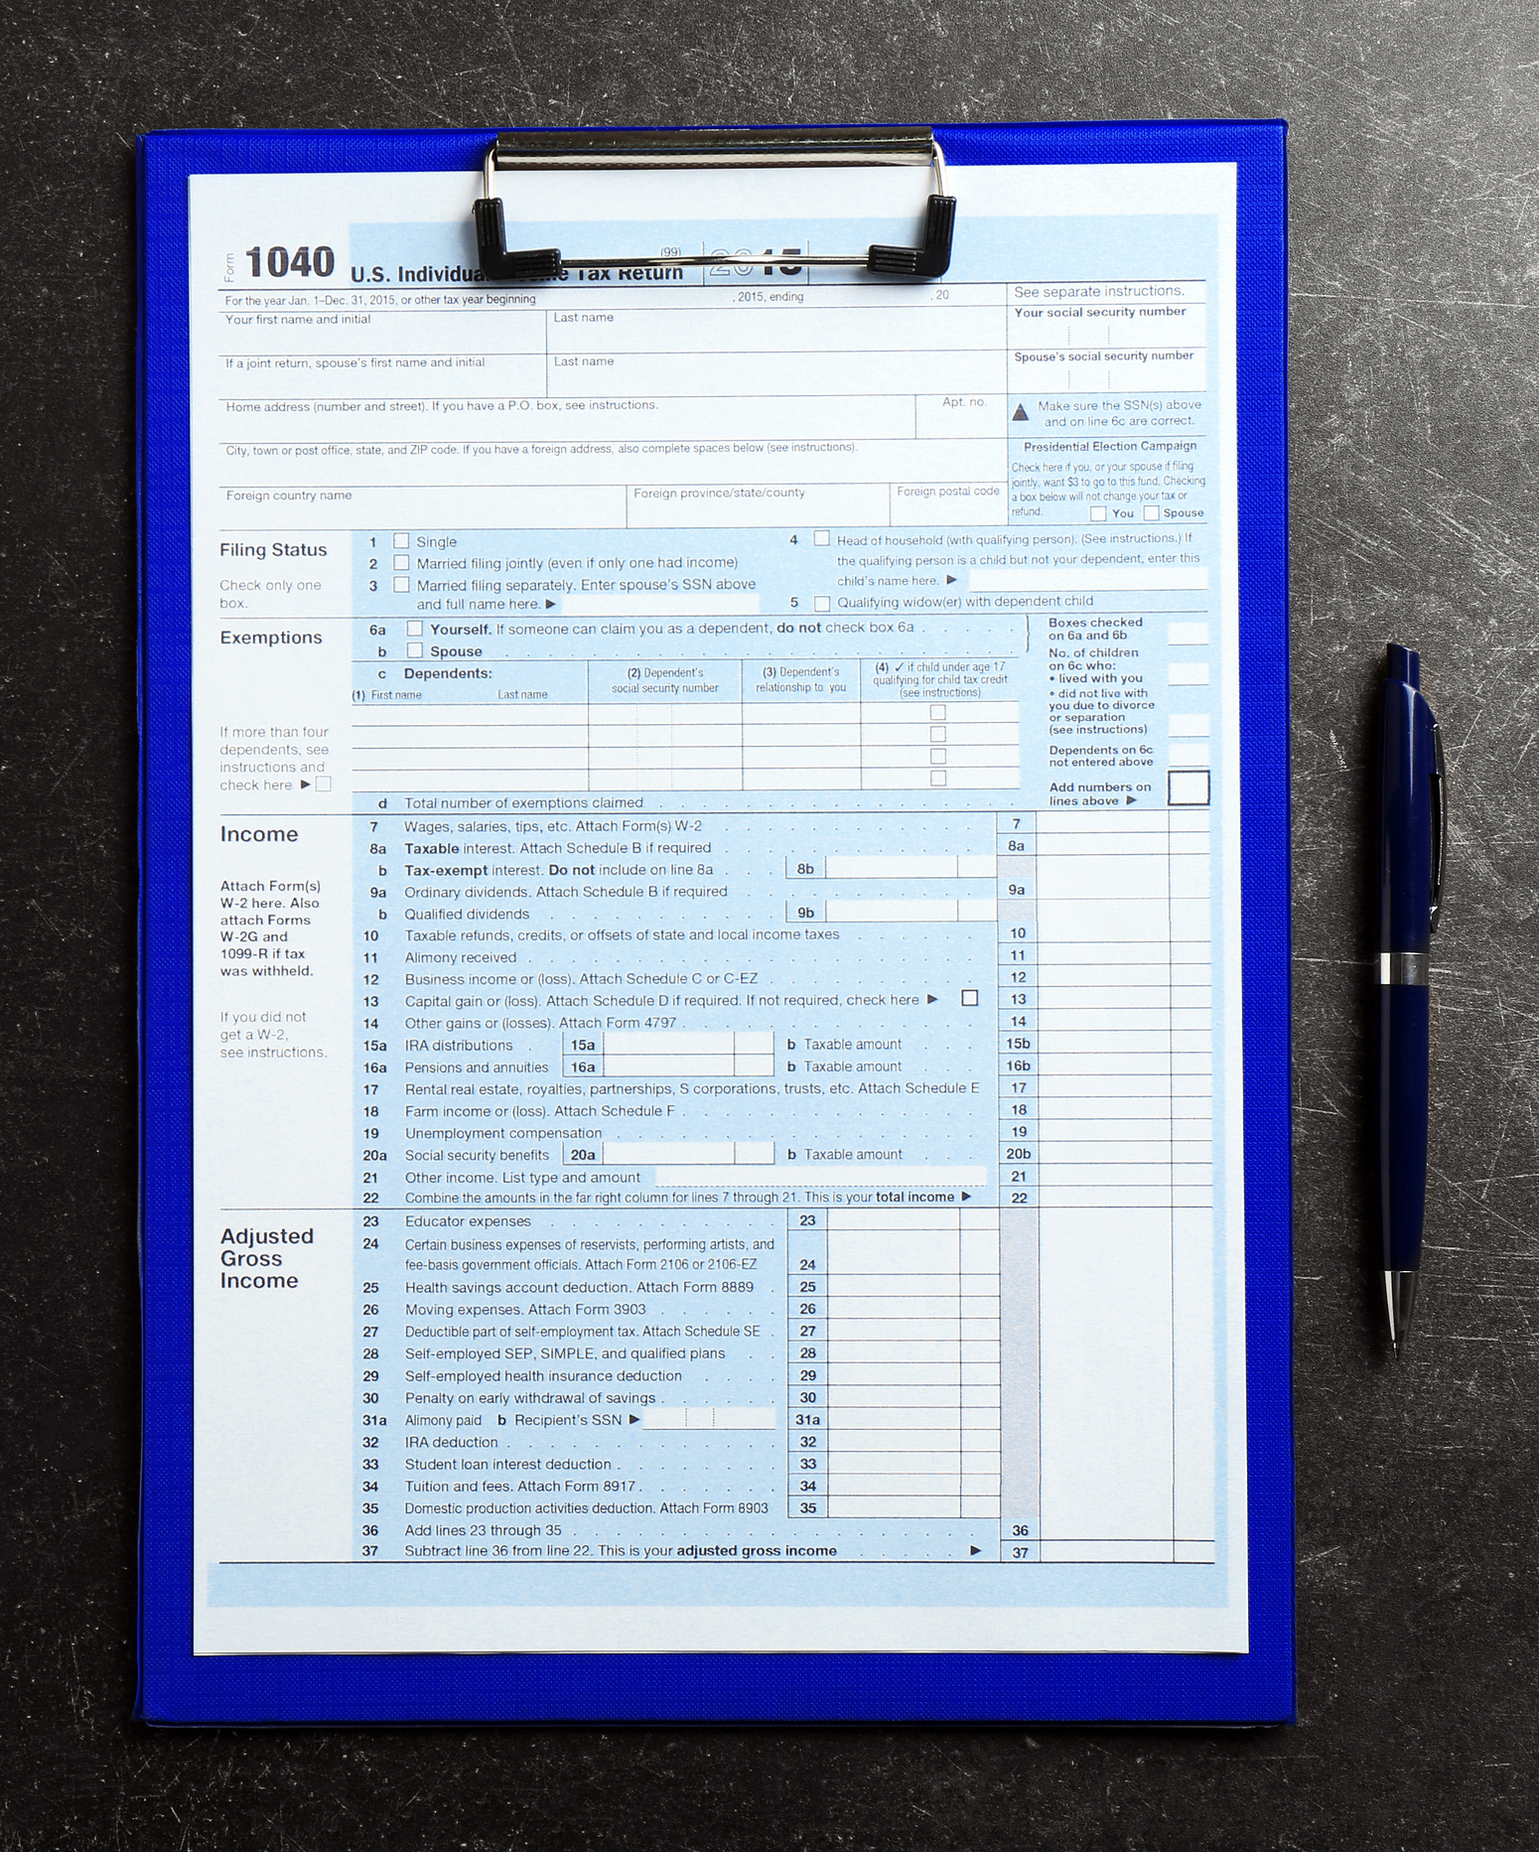
Forms and Inputs
Input Elements
The <form> Element
The <select> Element
GET and POST

Slide 2
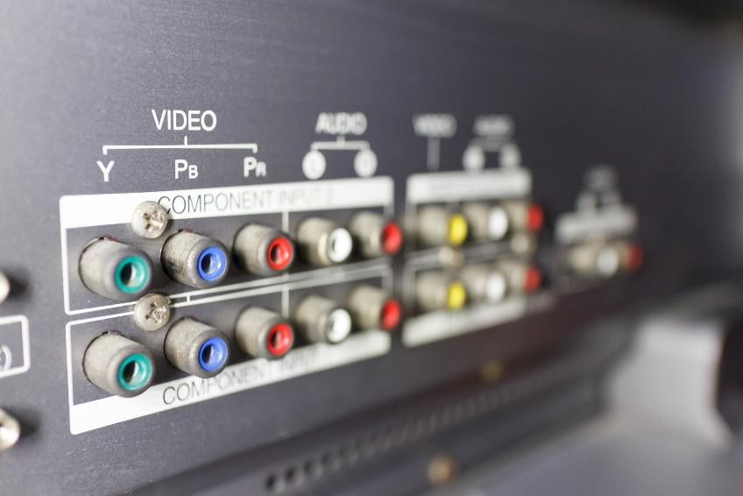
See Also
https://www.w3schools.com/html/html_forms.asp
https://www.tutorialspoint.com/html/html_forms.htm

Slide 3
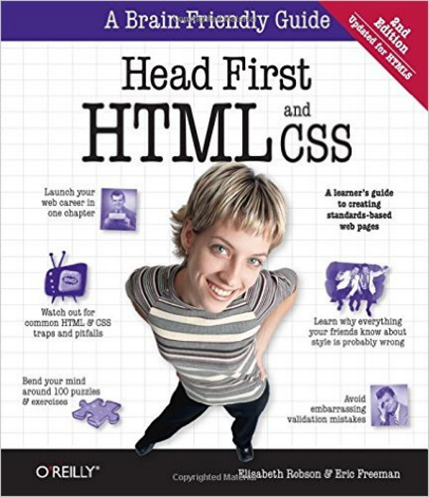
In the Book
Chapter 14:
HTML Forms

Slide 4
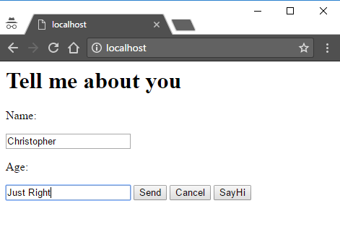
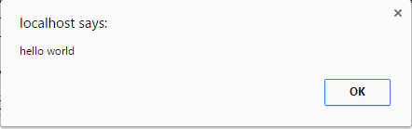
Input Elements
<html>
<head></head>
<body>
<h1>Tell me about you</h1>
<p>Name:</p>
<input type="text">
<p>Age:</p>
<input type="text">
<input type="button" value="Send">
<input type="button" value="Cancel">
<input type="button" value="SayHi" onclick="alert('hello world')">
</body>
</html>

Slide 5
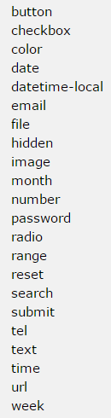
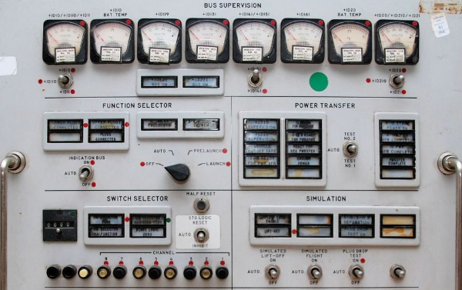
Lots of Input Types
Some new in HTML5
Some input controls aren’t <input>
JavaScript can access these input values
The <form> element sends the values to the server

Slide 6
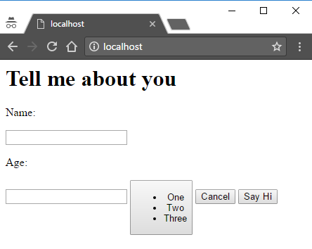
The Button
<button name="send">
<ul>
<li>One</li>
<li>Two</li>
<li>Three</li>
</ul>
</button>
<button name="cancel">Cancel</button>
<button name="hi" onclick="alert('hello world')">Say Hi</button>
Button allows you to put HTML inside
It seems/looks/reads more natural
Very old versions of IE had trouble with it

Slide 7



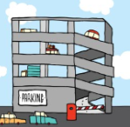

Dynamic Content
File
Server
Client
GET /index.html
File
GET /park.jpg
GET /weather.html
Client doesn’t know if the return is static or dynamic.
Any type of content could be generated.
Program

Slide 8
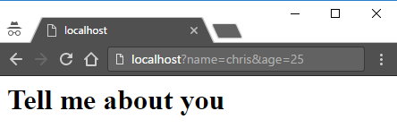
Query Parameters
http://ruler.com/localhost/test.html?name=chris&age=25
Everything after the question mark
Key=value
Separated with ampersands
Value is optional (just a key)
The same key can be listed many times
Ignored in static requests (try it)
Used by programs generating content

Slide 9
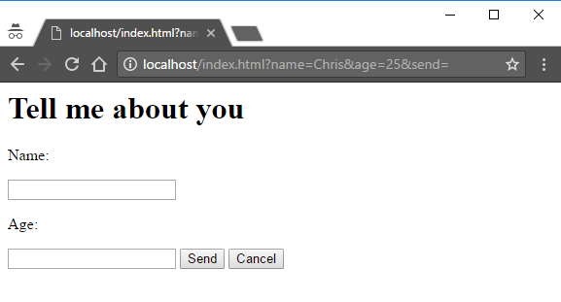
The <form>
<html>
<head></head>
<body>
<h1>Tell me about you</h1>
<form action="/index.html" method="GET">
<p>Name:</p>
<input type="text" name="name">
<p>Age:</p>
<input type="text" name="age">
<button type="submit" name="send">Send</button>
<button type="reset" name="cancel">Cancel</button>
</form>
</body>
</html>
Where to go (like in <a>)
Wait a couple of slides
“name” is the KEY
Which button was pressed.
We generally don’t care.
(Leave off the “name”)
index.html?name=chris&age=25&send=

Slide 10
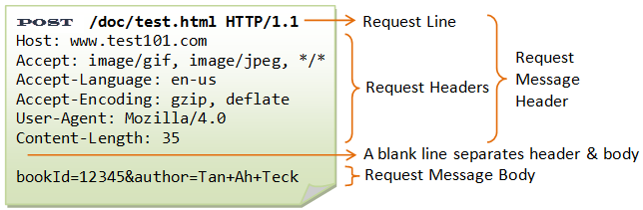
Post
index.html?name=username=ccantrell&password=ILoveUnicorns
OOPS
<form action="/index.html" method="POST">
<p>Name:</p>
<input type="text" name="name">
<p>Age:</p>
<input type="text" name="age">
<button type="submit">Send</button>
<button type="reset">Cancel</button>
</form>
The method (GET, POST, others)
Instead of going here …
… parameters go here.

Slide 11


GET and POST
With GET the parameters are visible (and bookmark-able)
With POST parameters are hidden (not bookmark-able)
POST is good for very large parameters like XML and JSON
The browser handles the return the same way – a new page to render

Slide 12
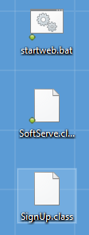
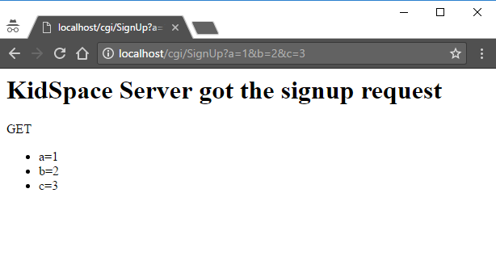
Dynamic SoftServe
public class SignUp {
public void get(String request, String query, PrintStream out,
String body, Map<String, String> fromServer)
{
out.println("HTTP/1.1 200 OK");
String ret =
"<h1>KidSpace Server got the signup request</h1>"+
"<p>GET</p>";
String [] params = query.split("&");
ret = ret + "<ul>";
for(String p : params) {
ret = ret + "<li>"+p+"</li>";
}
ret = ret + "</ul>";
SoftServe.sendContent(out, "text/html", ret);
}
}
blah/blah/cgi/SignUp?a=1&b=2

Slide 13
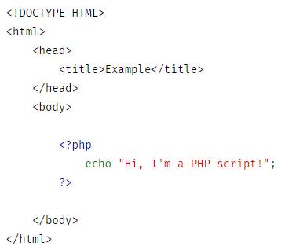
Generating Dynamic Content
Notice “print strings” in the code
HTML and Java mixed up together (you need to know both)
Do you have more code or more HTML?
Template languages allow you to sprinkle code into mostly-HTML:
PHP ( PHP: Hypertext Preprocessor)
JSP (Java Server Pages)
Facelets, Hamlets, Kid, etc

Slide 14
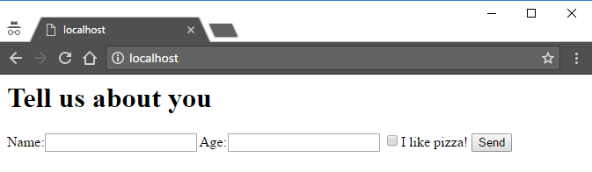
Formatting a Form
<html>
<head></head>
<body>
<h1>Tell us about you</h1>
<form action="/cgi/Hello" method="GET">
Name:<input type="text" name="name">
Age:<input type="text" name="age">
<input type="checkbox" name="pizza">I like pizza!
<button type="submit" name="send">Send</button>
</form>
</body>
</html>

Slide 15
Formatting a Form
Table display
Name:
<form id="about" action="/index.html" method="GET">
<div class="formRow">
<p class="left">Name:</p>
<p class="right"><input type="text" name="name"></p>
</div>
<div class="formRow">
<p class="left">Age:</p>
<p class="right"><input type="text" name="age"></p>
</div>
<div class="formRow">
<p class="left"></p>
<p class="right"><input type="checkbox" name="pizza">I like pizza!</p>
</div>
<div class="formRow">
<p class="left"></p>
<p class="right"><button type="submit" name="send">Send</button></p>
</div>
</form>
Table rows
Age:
I like pizza:
I like pizza
Table cells
Send

Slide 16
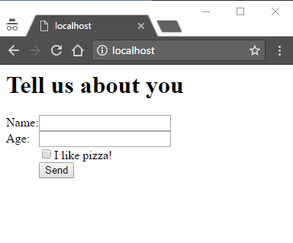
Formatting a Form
#id {
display: table;
}
.formRow {
display: table-row;
}
.left, right {
display: table-cell;
}

Slide 17
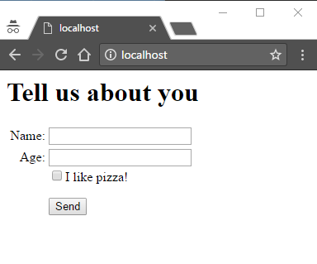
Formatting a Form
#id {
display: table;
}
.formRow {
display: table-row;
}
.left, right {
display: table-cell;
padding: 4px;
}
.left {
text-align: right;
}
.topGap {
margin-top: 16px;
}
<button class="topGap" type="submit" name="send">Send</button>

Slide 18
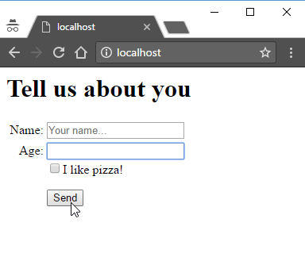

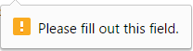
Placeholder and Required
<input type="text" name="name" placeholder="Your name...">
<input type="text" name="age" required>

Slide 19
Labels
<label for="field1">Name:</label>
<input id="field1" type="text" name="name" placeholder="Your name...">
<input id="pizza" type="checkbox" name="pizza">
<label for="pizza">I like pizza!</label>
Give the input field an ID
Match the “for” attribute to the ID
Adds structure to your HTML (like nav, header, footer, etc.)
Helps screen readers for the visually impaired

Slide 20
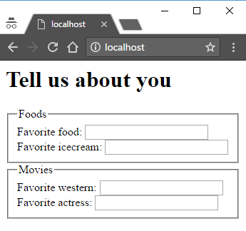
Fieldset and Legend
<form>
<fieldset>
<legend>Foods</legend>
Favorite food: <input><br>
Favorite icecream: <input>
</fieldset>
<fieldset>
<legend>Movies</legend>
Favorite western: <input><br>
Favorite actress: <input>
</fieldset>
</form>

Slide 21
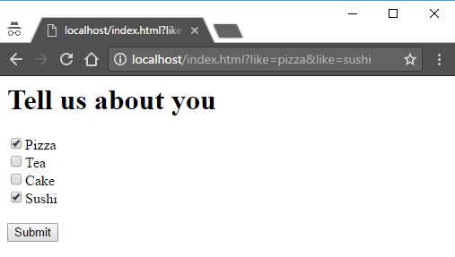
Checkboxes
<form id="about" action="/index.html" method="GET">
<input type="checkbox" name="like" value="pizza" checked>Pizza<br>
<input type="checkbox" name="like" value="tea">Tea<br>
<input type="checkbox" name="like" value="cake">Cake<br>
<input type="checkbox" name="like" value="sushi" checked>Sushi<br>
<br>
<input type="submit">
</form>

Slide 22
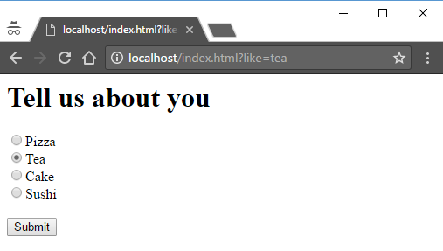
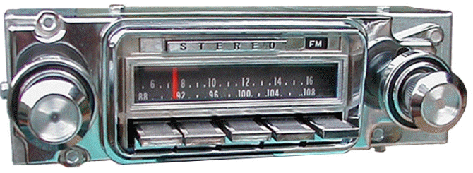
Radio Buttons
<form id="about" action="/index.html" method="GET">
<input type="radio" name="like" value="pizza" checked>Pizza<br>
<input type="radio" name="like" value="tea">Tea<br>
<input type="radio" name="like" value="cake">Cake<br>
<input type="radio" name="like" value="sushi">Sushi<br>
<br>
<input type="submit">
</form>

Slide 23
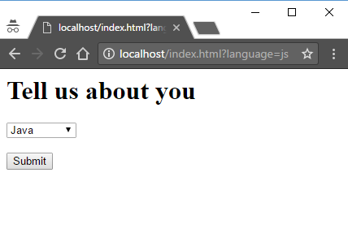
Select
<form id="about" action="/index.html" method="GET">
<select name="language">
<option value="java">Java</option>
<option value="cpp">C++</option>
<option value="js">JavaScript</option>
</select>
<br><br>
<input type="submit">
</form>

Slide 24
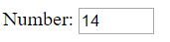
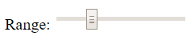
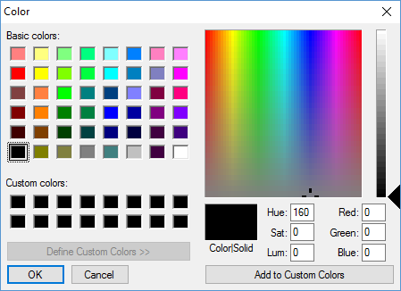
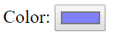
Many More
Number: <input name="a" type="number" min="10" max="50">
Range: <input name="b" type="range" min="10" max="50" step="5">
Color: <input name="c" type="color">

Slide 25
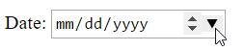
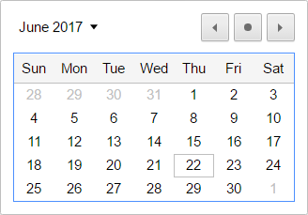
Many More
Date: <input name="b" type="date">
Email: <input name="a" type="email">
Telephone: <input name="c" type="tel">
Customized keyboards on mobile devices.
Could use the device’s contact lists.

Slide 26
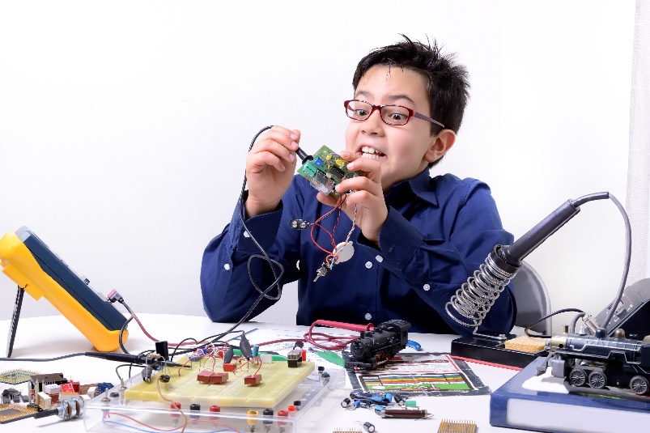
Tinkering
Create a <form> with GET (so you can see the values).
Experiment with the various form inputs we’ve discussed. Look up some we haven’t.
Experiment to find out how the “color” input send its value?

